Slide 1
Presentation
Jiayu Chen

Slide 2
Outline
Part_1: Analysis of Zaid’s Design
Part_2: My Design
Part_3: Current Results
Part_4: Next Step

Slide 3
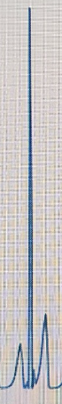
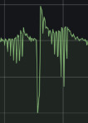
Analysis of Zaid’s Design
Initial Analysis
Zaid’s Approach:
Generate one piece of ECG signal.
Amplitude of generated ECG signal -> Motor’s average voltage, ie., 0 -> 0V, 100(R peak) -> 3.3V.
The signal received by BedDot approximately equals the original ECG signal multiplied by -1 and then sampled.
The sampling rate is equal to the time resolution of the generated ECG signal.
Conclusion
Amplitude of the Received Signal
The amplitude of the received signal is positively proportional to the duty circle(average voltage) of the motor, but not linearly correlated.
Received signal = real signal * kernel (* is convolution). According to Zaid’s experiments, the kernel of our system should be easy.
Duty Circle

Slide 4
Analysis of Zaid’s Design
Further Analysis: Frequency
Outputs of Zaid’s Simulator are high frequency. The frequency of small peaks is equal to the time resolution of the generated ECG signal.
However, the number of peaks in BSG signals is around 4-9, indicating the motor should operate at a low frequency (4-9 times per heartbeat cycle) rather than the 30 times shown in the left figure.
Conclusion:
We should use the motor to simulate the heart's physical process with low-frequency pulsations, rather than driving the motor based on the generated heartbeat waveform.
Correct Process
How heart pulse?
How to operate the motor like hearts?
Are received waveforms similar to real data?
Zaid’s Process
How waveforms look like?
Operate the motor based on waveforms.

Slide 5
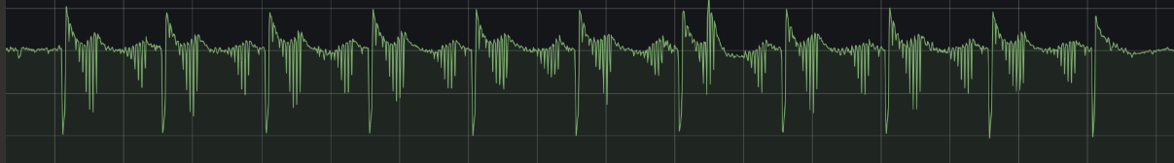
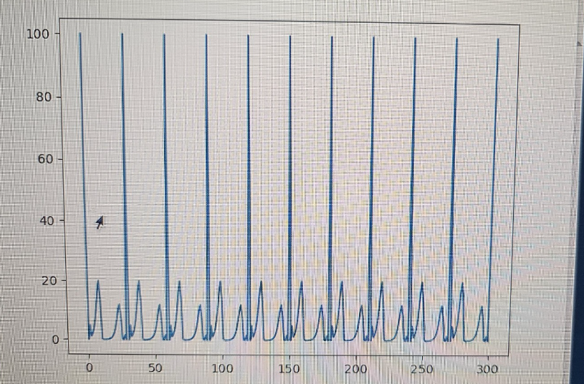
Analysis of Zaid’s Design
Further Analysis: Amplitude
Uncontrol
Control
Zaid’s Approach：the Amplitude of generated ECG signal -> Motor’s average voltage.（0 -> 0V, 100 -> 3.3V）
Disadvantages: The standardized BSG signal has both positive and negative values. However, the voltage cannot be negative, only half amplitude can be controlled.
In Zaid’s example, the portion below the yellow line is controllable, while the portion above the yellow line is uncontrolable.
Push
Push
How is the portion above the yellow line generated?
Gravity
Gravity
Below yellow line
Above yellow line

Slide 6
Analysis of Zaid’s Design
Conclusion:
We should use the motor to simulate the heart's physical process with low-frequency pulsations, rather than driving the motor based on the generated heartbeat waveform.
Zaid’s approach can only control a portion of amplitude.
Zaid’s Simulator produces clear waveforms, indicating a high SNR. I should ask him how to improve the SNR.

Slide 7
My Design
PUSH
PULL
L9110
Motor
Pi
Control the motor’s low-frequency vibration by switching the polarity of the voltage at the motor pins using the L9110.
Simulating the low-frequency pulsation of a heartbeat
When the voltage polarity is reversed, the two parts of the motor will be tightly attracted, allowing control of the other half of the amplitude, rather than relying solely on gravity.

Slide 8
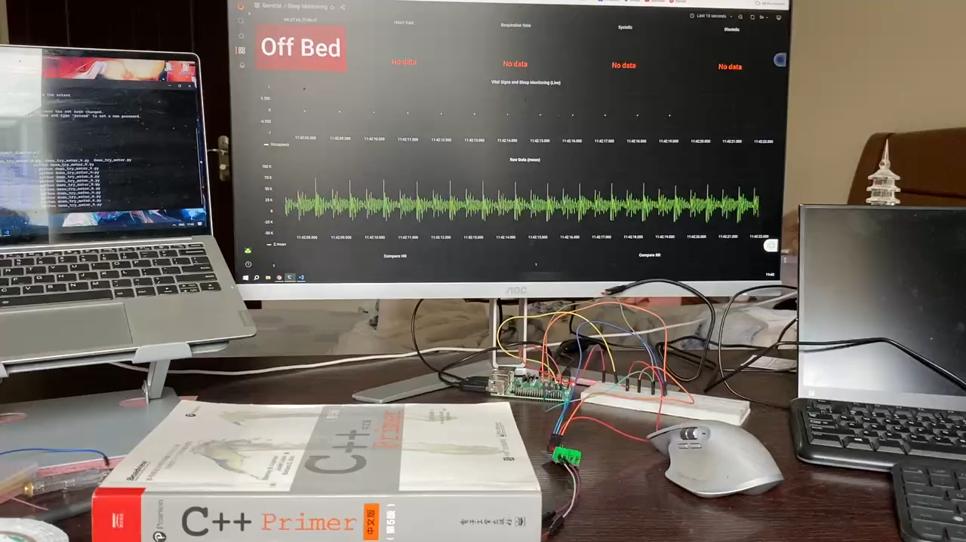

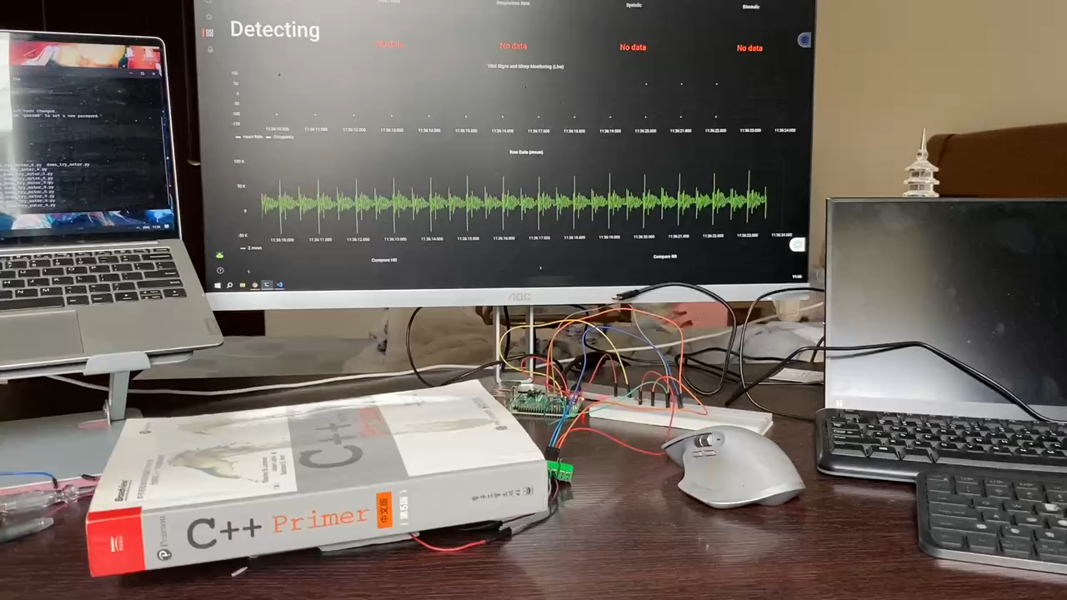
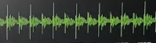
Current Results
Only the PUSH force is used, without utilizing the PULL force.
The part within the yellow box is what we control with the motor; the rest is noise.
Both PUSH and PULL forces are used.
We can use the PULL force to control the other side of the amplitude.

Slide 9
Current Results
There are many ripples. There should only be one peak(within the yellow box) caused by us. Here are two reasons:
Rigid collisions
Noise: The white noise level is 10-20K, which overlaps with the ripples.
I believe noise is the main factor.
Zaid's graph is clear, possibly due to the use of a higher-power motor. I suggest purchasing a higher-power motor to achieve better results.

Slide 10
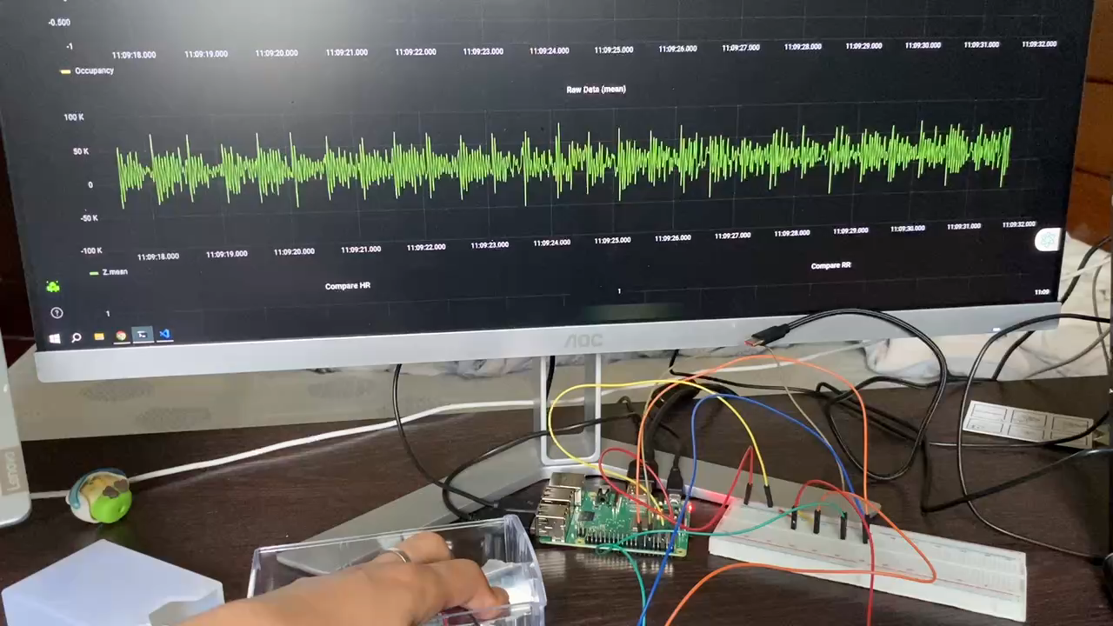
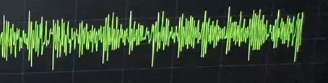
Current Results
Rigid collisions are not eliminated.
After minimizing rigid collisions as much as possible.

Slide 11
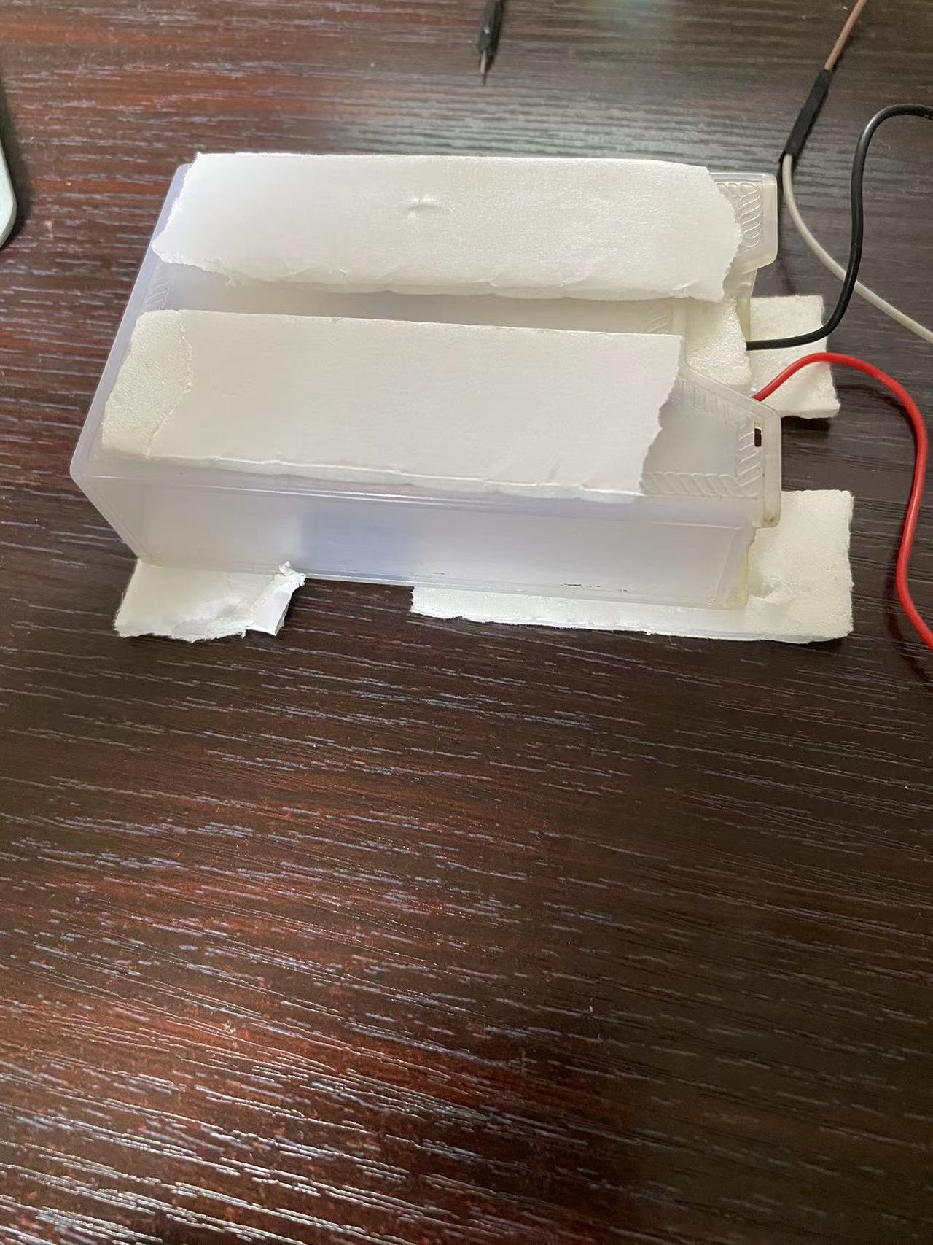
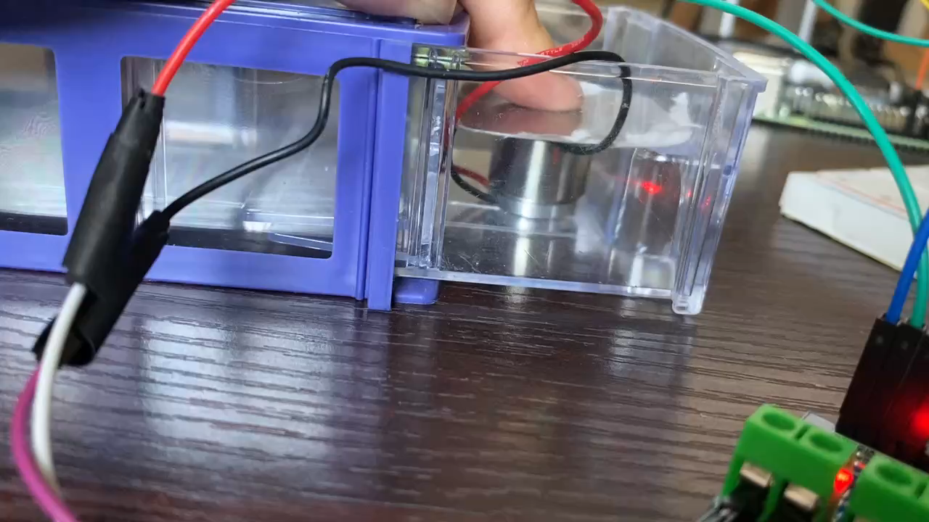
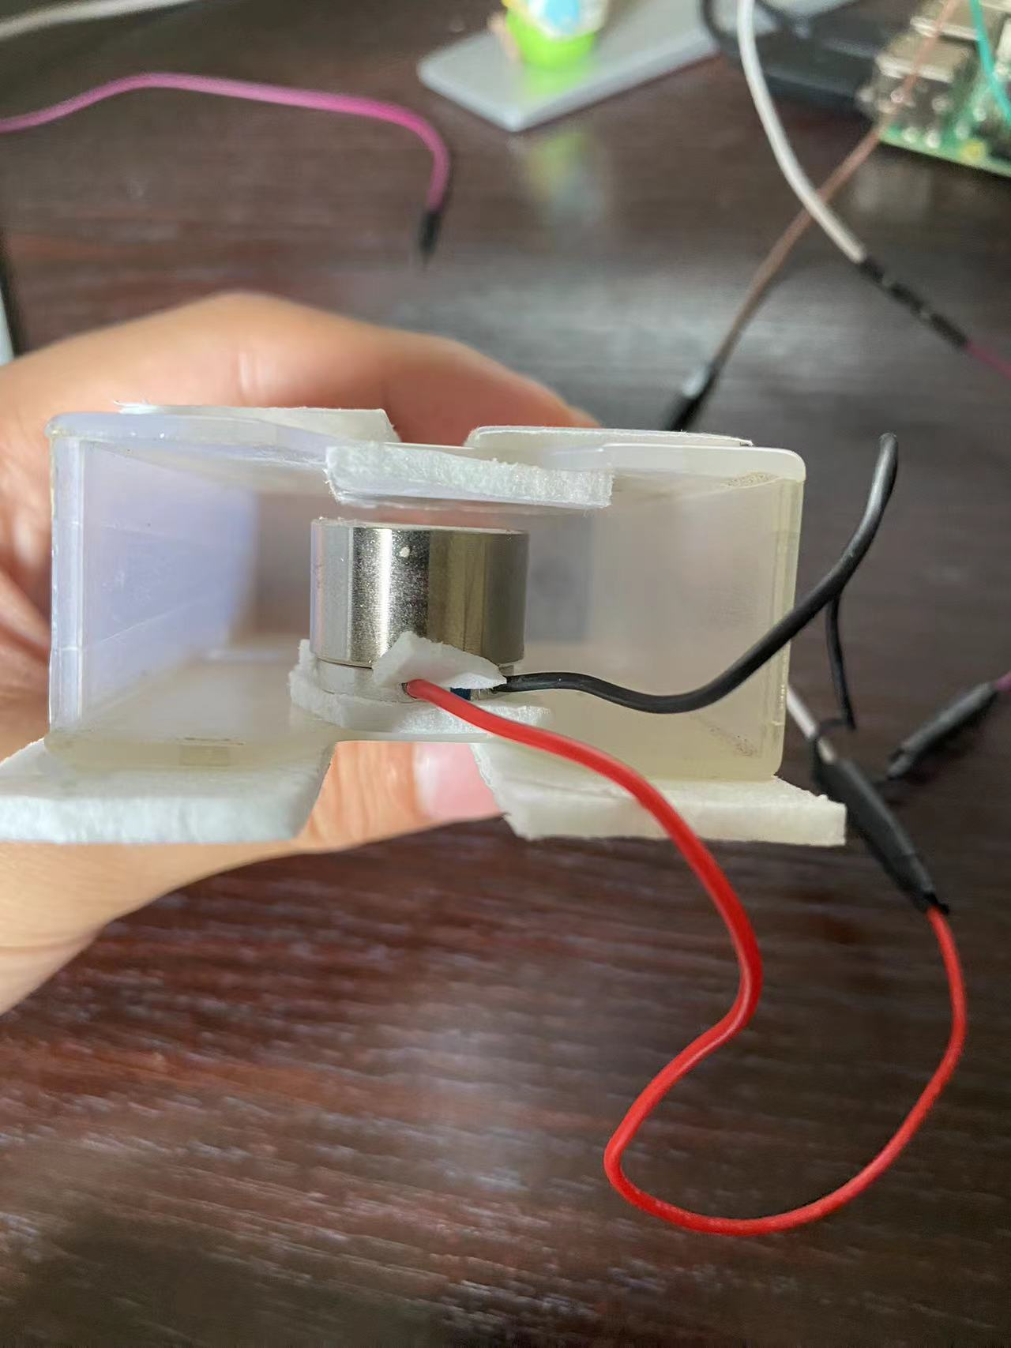

Slide 12
